Slide 1
A tour across the ROC and PR spaces & curves
Alessandro Morita Gagliardi
Journal Club – August 2021
LatAm Datalabs

Slide 2
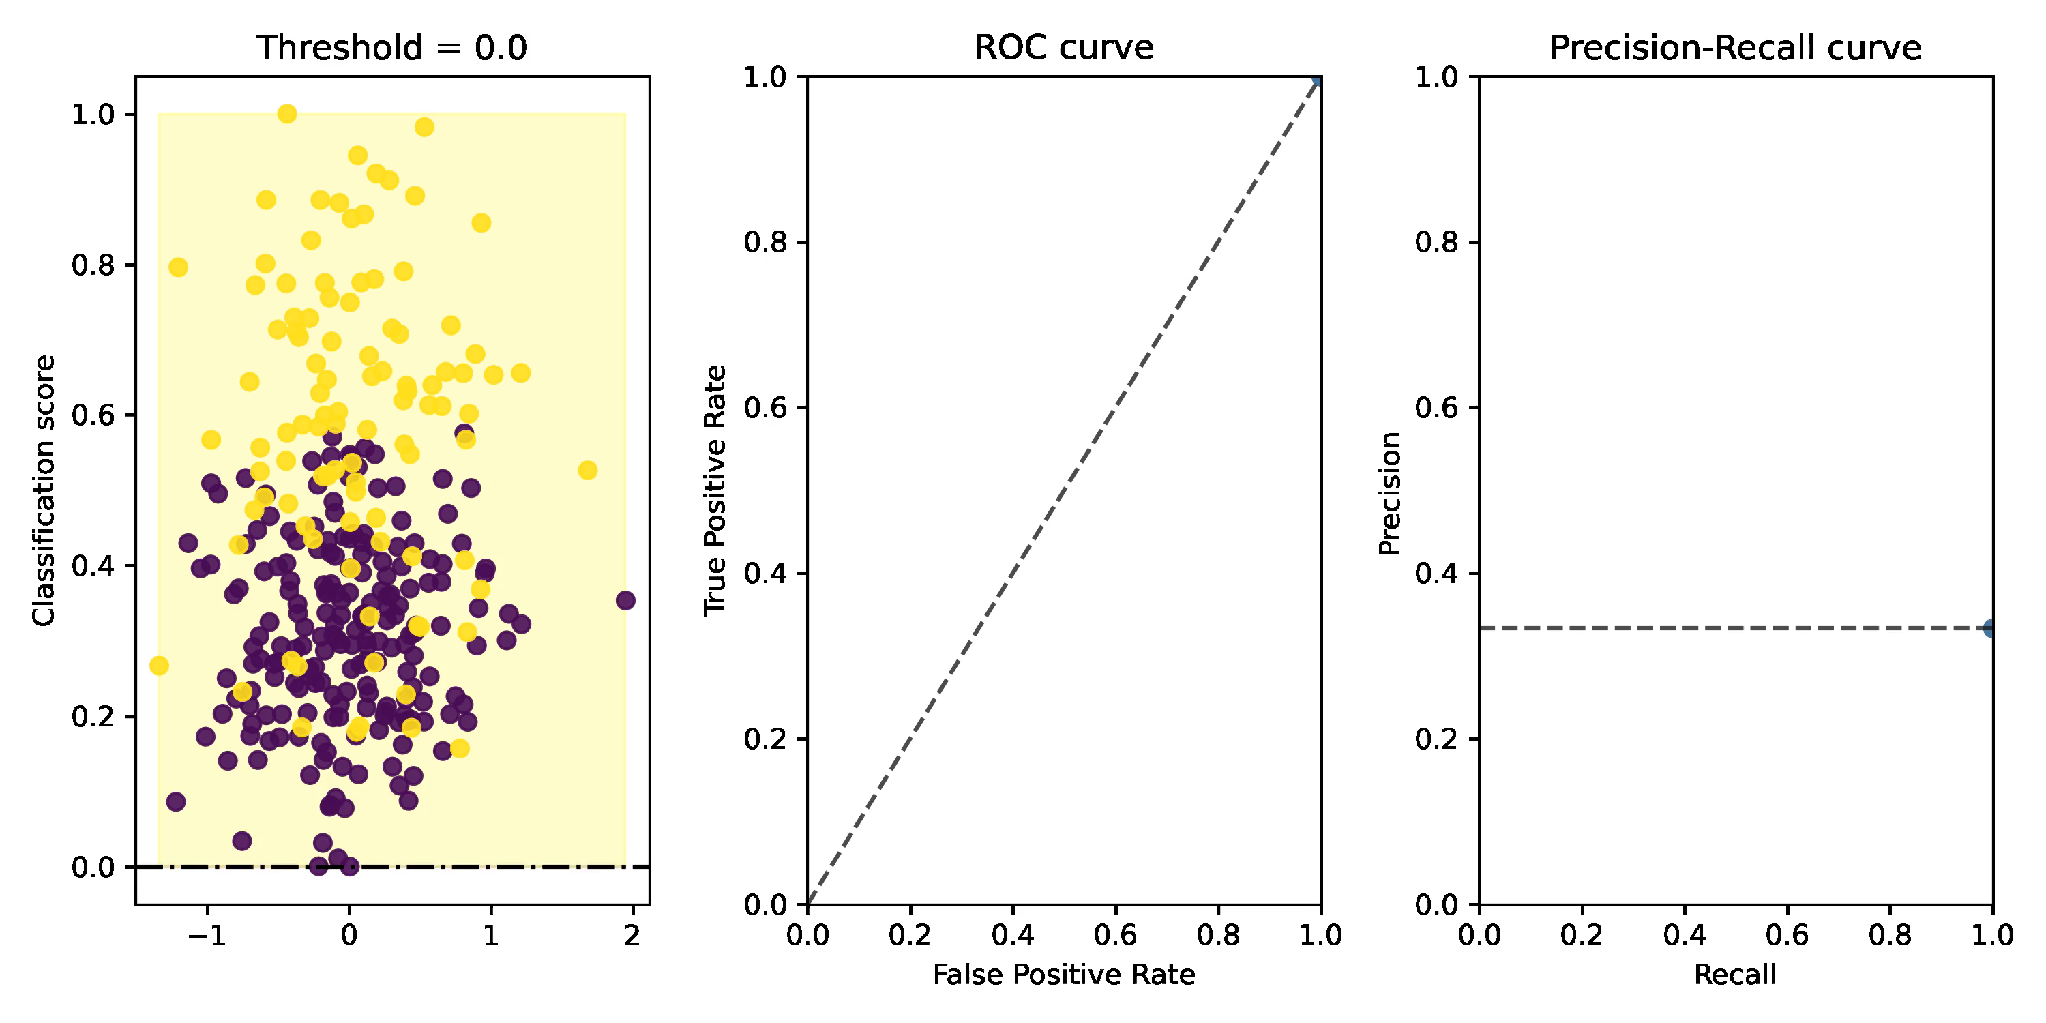
Lighting review: ROC and PR curves
(with recall = true positive rate = sensitivity…)

Slide 3
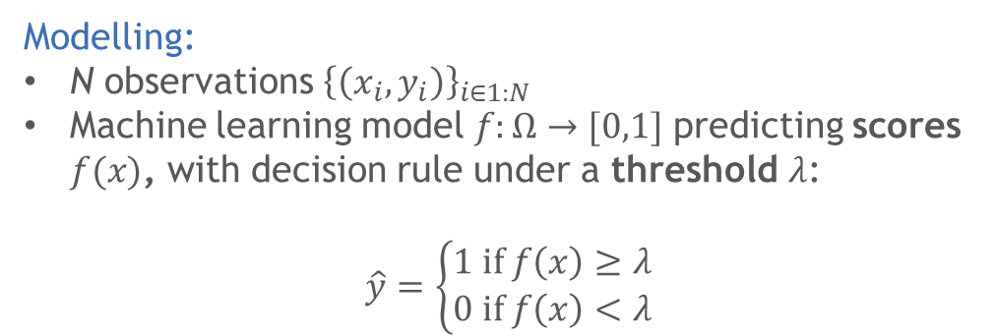
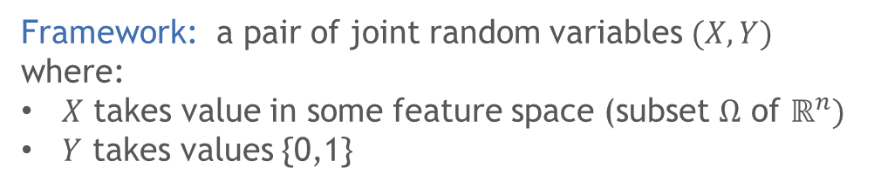
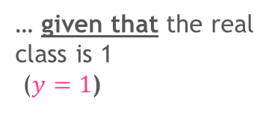
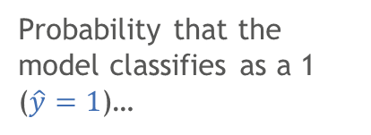
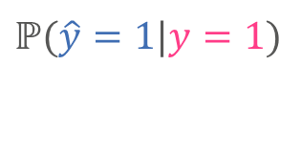
Let us fix the notation to be used today
Binary classification problem
Our main tool for today
Framework: a pair of joint random variables $(X,Y)$ where:
$X$ takes value in some feature space (subset $Ω$ of $ℝ^{n})$
$Y$ takes values {0,1}
Conditional probabilities:
Ex:
$$ℙ(\hat{y}=1|y=1)$$
Probability that the model classifies as a 1 ($\hat{y}=1$)…
Modelling:
N observations ${\left\{\left(x_{i},y_{i}\right)\right\}}_{i∈1:N}$
Machine learning model $f:Ω→[0,1]$ predicting scores $f(x)$, with decision rule under a threshold $λ$:
$\hat{y}=\left\{\begin{aligned}1 if f\left(x\right)≥λ \\ 0 if f\left(x\right)<λ\end{aligned}\right.$
… given that the real class is 1 ($y=1$)

Slide 4
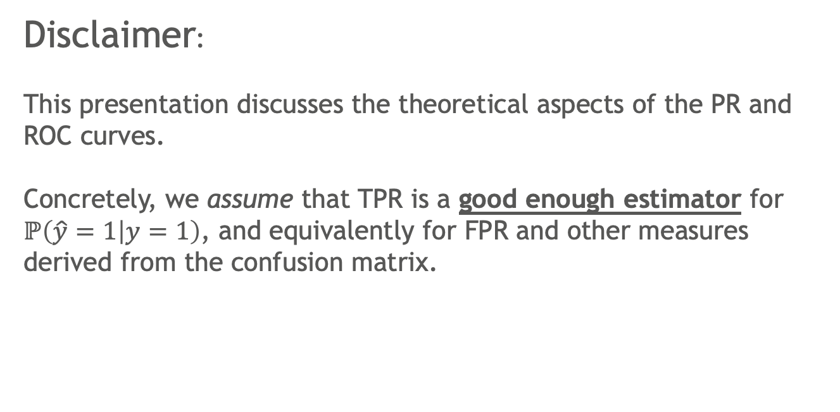
Disclaimer:
This presentation discusses the theoretical aspects of the PR and ROC curves.
Concretely, we assume that TPR is a good enough estimator for $ℙ\left(\hat{y}=1 | y=1\right)$, and equivalently for FPR and other measures derived from the confusion matrix.

Slide 5



Back to ROC and PR curves – with probabilities

Slide 6
Part I
The ROC curve

Slide 7
Four fantastic unique properties of the ROC curve
1
Interpretable area under the curve (AUC ROC)
2
Balance-invariance
3
Universal baseline
4
Linearity & the convex hull
(convexity)

Slide 8
Four fantastic unique properties of the ROC curve
1
Interpretable area under the curve (AUC ROC)
2
Balance-invariance
3
Universal baseline
4
Linearity & the convex hull
(convexity)

Slide 9
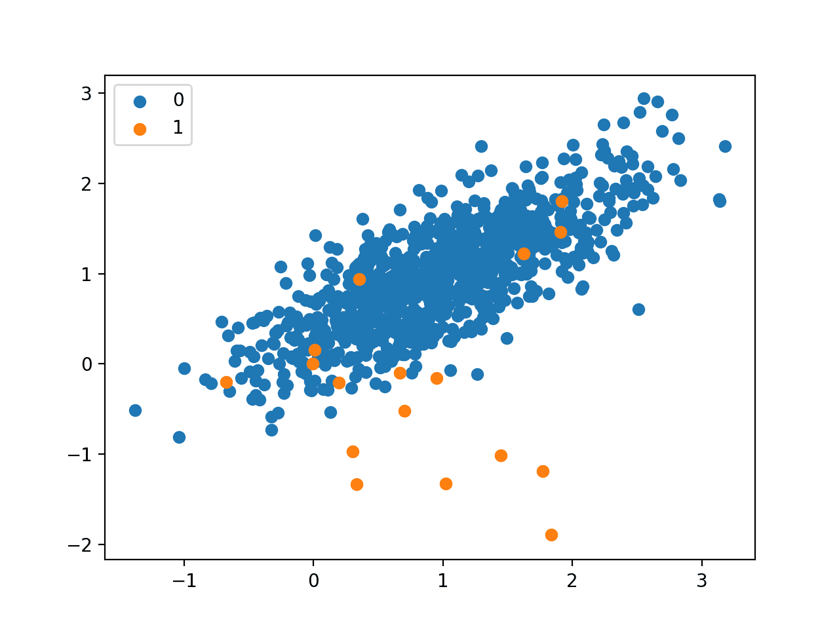
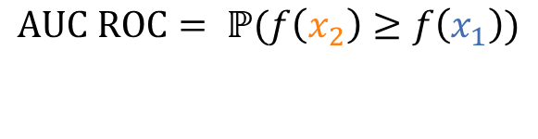
The AUC has a straightforward probabilistic interpretation
Process:
1
Randomly take a point from the blue (negative) class, $x_{1}$
2
Use the ML model to calculate its score, $f(x_{1})$
3
Now randomly take a point from the orange (positive) class, $x_{2}$
4
Use the ML model to calculate its score, $f(x_{2})$
Claim:
$$AUC ROC= ℙ(f\left(x_{2}\right)≥f\left(x_{1}\right))$$
AUC measures the probability that any point from the positive class will be more highly scored than a point from the negative class

Slide 10

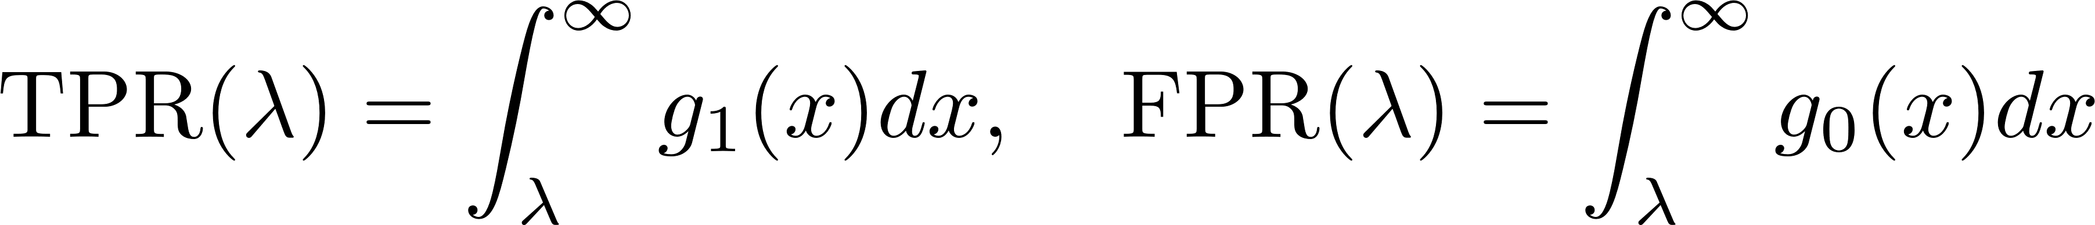
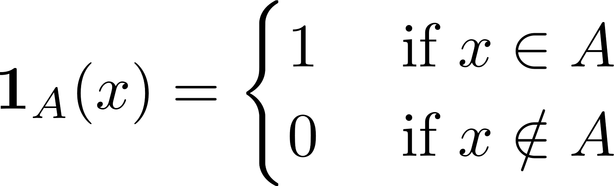


Proof
$$λ=−∞$$
By definition
. It is natural to parameterize FPR and TPR via the threshold $λ$ since
TPR
and
. This motivates us to define the independent
.
random variables
$$λ=+∞$$
FPR
Letting their densities be $g_{1}, g_{0}$ respectively allows us to write
which can be plugged in into the definition of AUC:
Here, we used the fundamental theorem of calculus on the third inequality and Fubini’s theorem on the fourth. We also used the indicator function
and identified $g_{0}⊗g_{1}$ as the PDF for $(X_{0},X_{1})$.

Slide 11
Four fantastic unique properties of the ROC curve
1
Interpretable area under the curve (AUC ROC)
2
Balance-invariance
3
Universal baseline
4
Linearity & the convex hull
(convexity)

Slide 12


Both FPR and TPR are unaffected by class imbalance The ROC curve (and the AUC) know nothing about proportion between classes
TPR and FPR only care about the ratios within the positive class or the negative class
They do not “see” the ratio between all positives and negatives
Spoiler: precision is affected!

Slide 13
Four fantastic unique properties of the ROC curve
1
Interpretable area under the curve (AUC ROC)
2
Balance-invariance
3
Universal baseline
4
Linearity & the convex hull
(convexity)

Slide 14
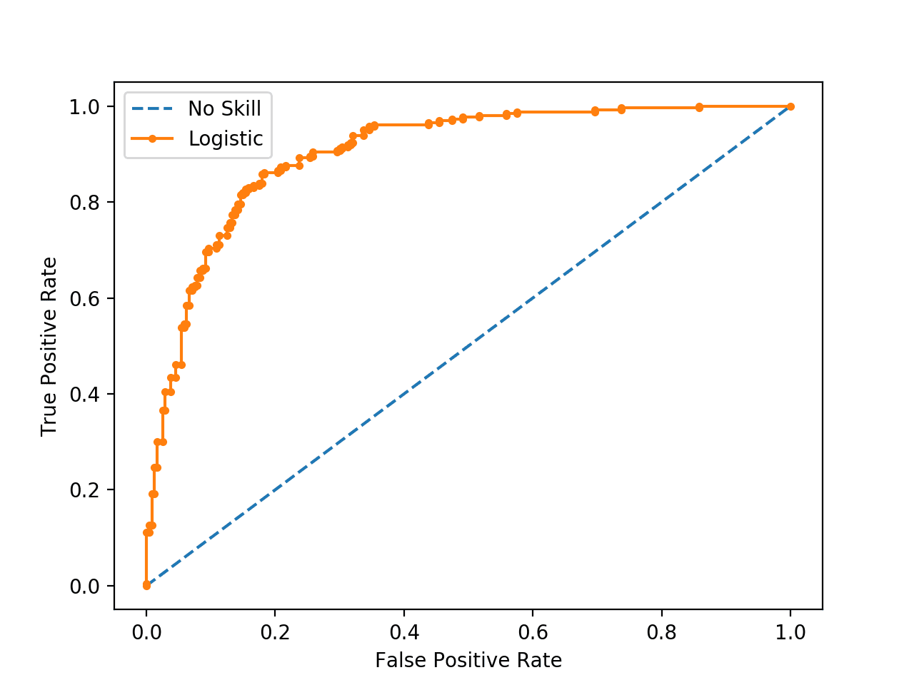

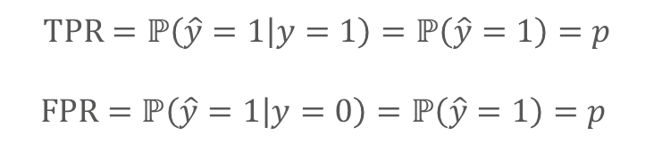
All models can be compared over the ROC space since there is a universal baseline – the diagonal
Why is the diagonal our base reference?
It is built out of biased coin tosses: a family of Bernoulli(p) “coin tosses”
$$TPR=ℙ\left(\hat{y}=1 | y=1\right)=ℙ\left(\hat{y}=1\right)=p$$
$$FPR=ℙ\left(\hat{y}=1 | y=0\right)=ℙ\left(\hat{y}=1\right)=p$$
Will guess with the same probability, regardless if the class is 1 or 0
Thus diagonal!

Slide 15
Four fantastic unique properties of the ROC curve
1
Interpretable area under the curve (AUC ROC)
2
Balance-invariance
3
Universal baseline
4
Linearity & the convex hull
(convexity)

Slide 16
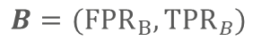
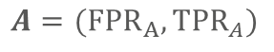
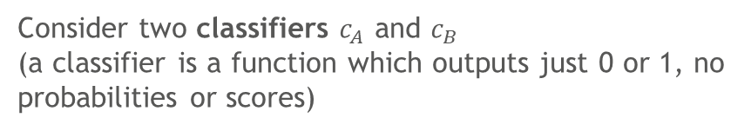
The structure of ROC space allows us to create new classifiers from old ones
1
Consider two classifiers $c_{A}$ and $c_{B}$
(a classifier is a function which outputs just 0 or 1, no probabilities or scores)
$$B=({FPR}_{B},{TPR}_{B})$$
True Positive Rate
$$A=({FPR}_{A},{TPR}_{A})$$
FPR (False Positive Rate)

Slide 17
The structure of ROC space allows us to create new classifiers from old ones
1
Consider two classifiers $c_{A}$ and $c_{B}$
(a classifier is a function which outputs just 0 or 1, no probabilities or scores)
$$B=({FPR}_{B},{TPR}_{B})$$
2
Construct a line segment between both classifiers in ROC space
True Positive Rate
$$A=({FPR}_{A},{TPR}_{A})$$
FPR (False Positive Rate)

Slide 18
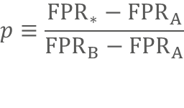
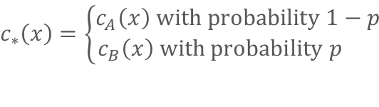
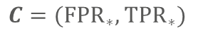
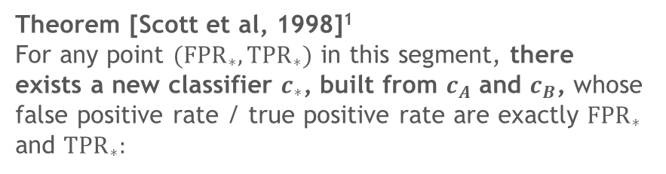
The structure of ROC space allows us to create new classifiers from old ones
1
Consider two classifiers $c_{A}$ and $c_{B}$
(a classifier is a function which outputs just 0 or 1, no probabilities or scores)
$$B=({FPR}_{B},{TPR}_{B})$$
2
Construct a line segment between both classifiers in ROC space
True Positive Rate
$$C=({FPR}_{∗},{TPR}_{∗})$$
3
Theorem [Scott et al, 1998]¹
For any point $({FPR}_{∗},{TPR}_{∗})$ in this segment, there exists a new classifier $c_{∗}$, built from $c_{A}$ and $c_{B}$, whose false positive rate / true positive rate are exactly ${FPR}_{∗}$ and ${TPR}_{∗}:$
$$A=({FPR}_{A},{TPR}_{A})$$
$$c_{∗}\left(x\right)=\left\{\begin{aligned}c_{A}\left(x\right) with probability 1−p \\ c_{B}\left(x\right) with probability p \end{aligned}\right.$$
FPR (False Positive Rate)
with
$$p≡\frac{{FPR}_{∗}−{FPR}_{A}}{{FPR}_{B}−{FPR}_{A}}$$
1. Proof: calculate FPR for this new model as $ℙ(c_{∗}\left(x\right)=1|y=0)$ and break this into $p ℙ\left(c_{B}\left(x\right)=1 | y=0\right)+(1−p)ℙ(c_{A}\left(x\right)=1|y=0)$, and simplify. Analogous calculation for TPR.

Slide 19
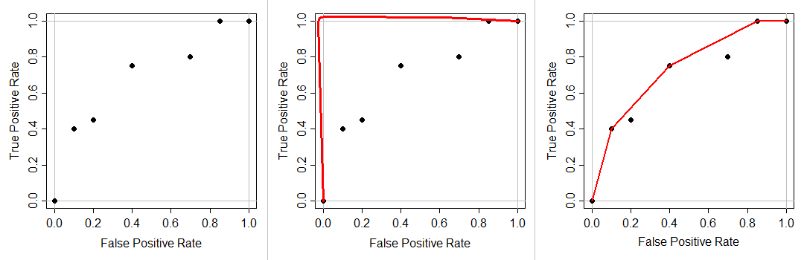
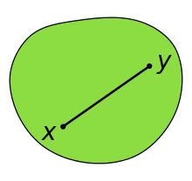
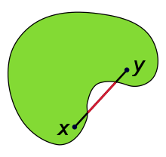


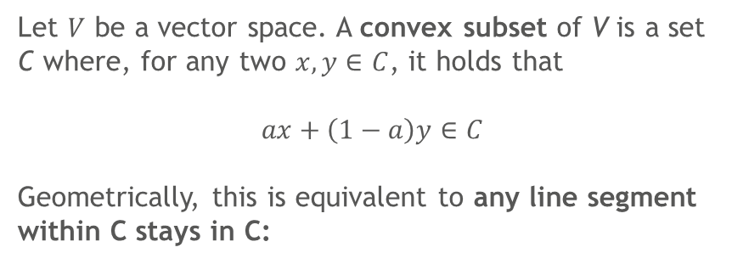
Why is this useful? Both practically and theoretically!
Theory:
ROC space is convex
Practice:
The convex hull – the optimal ROC curve
Let $V$ be a vector space. A convex subset of V is a set C where, for any two $x,y∈C$, it holds that
$$ax+\left(1−a\right)y∈C$$
Geometrically, this is equivalent to any line segment within C stays in C:
From the set of points obtained experimentally via modelling, we can “ throw a rubber band” over them and create an optimal ROC curve, by joining the boundary classifiers
Convex
Non-convex

Slide 20
Part II
The PR curve

Slide 21
The PR curve shares none of the ROC’s advantages
ROC curve
PR curve
Interpretable area under the curve (AUC ROC)
No interpretation for the area (but some people still use it…)
Balance-invariance
The whole curve shifts when class balance shifts
Universal baseline
No universal baseline – only baseline is the class imbalance ratio
Linearity & the convex hull
(convexity)
Not linear – convex hull has no meaning

Slide 22
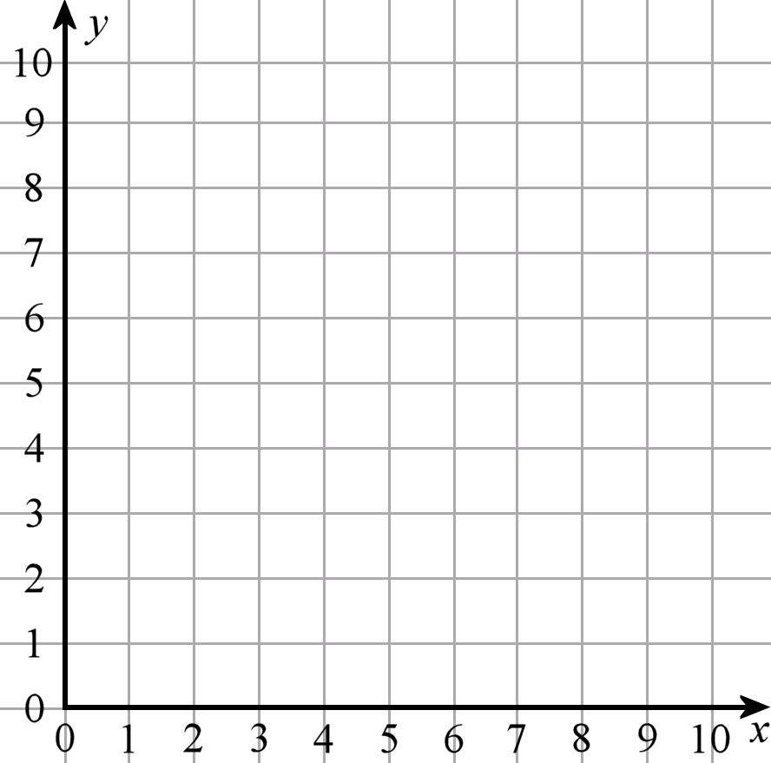



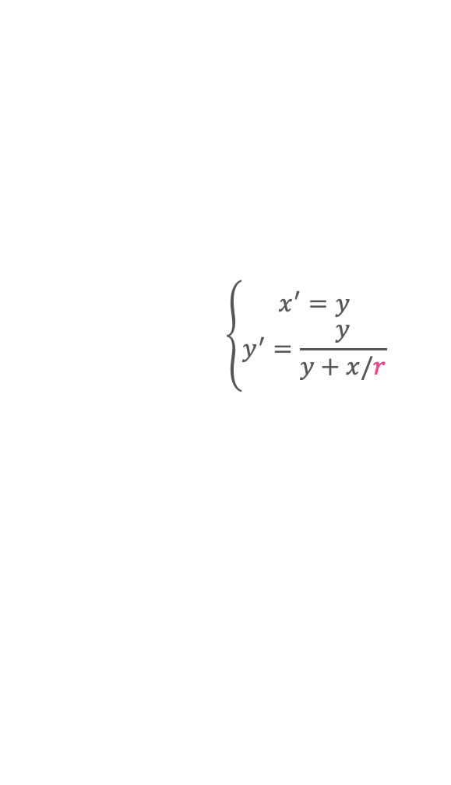
In a way, we can see ROC and PR as coordinates for the same space – a class-imbalance-dependent coordinate transformation
ROC ($x=FPR,y=TPR)$
PR ($x′=Recall,y′=Precision)$
’
$$\left\{\begin{aligned}x^{′}=y \\ y^{′}=\frac{y}{y+x/r}\end{aligned}\right.$$
`
Inversible transformation which depends on the class proportion rate $r=\frac{positives}{negatives}$
`
r =1: perfect balance
r << 1: highly imbalanced
’
Proof: a direct application of Bayes theorem, since precision = $P\left(y=1 | \hat{y}=1\right)=P\left(\hat{y}=1 | y=1\right)P(y=1)/P(\hat{y}=1)$. The denominator can be expanded in terms of conditionals, and the whole thing can be divided by $P(y=1)/P(y=0)$ which is by definition r.

Slide 23
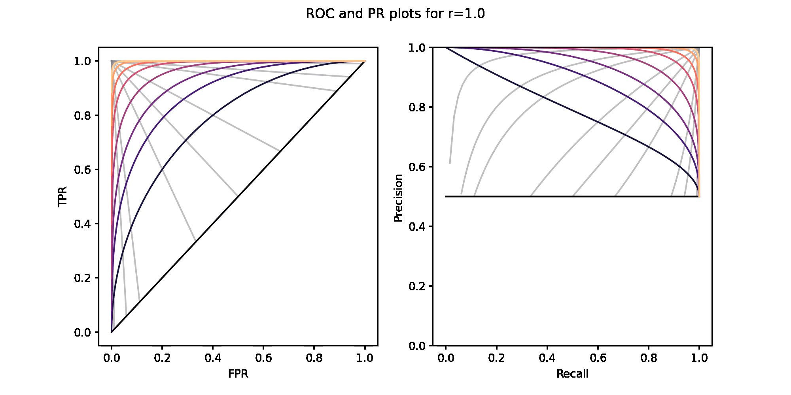
Class imbalance – how much is PR affected?
r: ratio between the positive class and negative class
r =1: perfect balance
r << 1: highly imbalanced

Slide 24
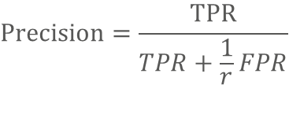
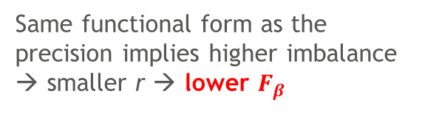
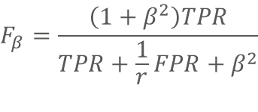
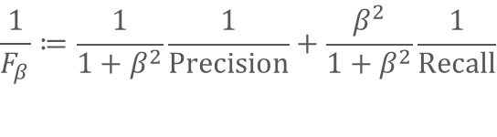

Besides precision, the $F_{1}$ (and all $F_{β}$) get worse with higher imbalance
Precision
$$Precision=\frac{TPR}{TPR+\frac{1}{r}FPR}$$
1
Higher imbalance → smaller r → lower precision
$$r=∞$$
$$\frac{1}{F_{β}}≔\frac{1}{1+β^{2}}\frac{1}{Precision}+\frac{β^{2}}{1+β^{2}}\frac{1}{Recall}$$
$$F_{β}=\frac{\left(1+β^{2}\right)TPR}{TPR+\frac{1}{r}FPR+β^{2}}$$
Same functional form as the precision implies higher imbalance → smaller r → lower $F_{β}$

Slide 25
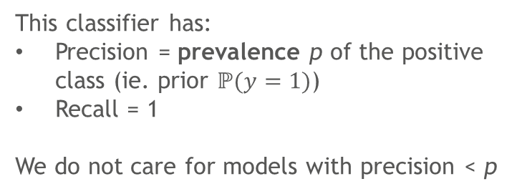
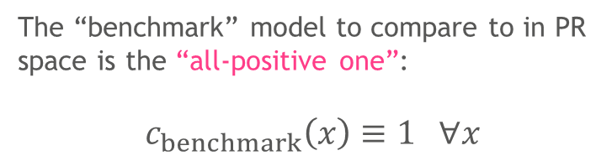
We can “fix” the PR curve by a smart choice of new coordinates (I/II)
Motivation
1
The “benchmark” model to compare to in PR space is the “all-positive one”:
$$c_{benchmark}\left(x\right)≡1 ∀x$$
Precision
This classifier has:
Precision = prevalence p of the positive class (ie. prior $ℙ(y=1)$)
Recall = 1
We do not care for models with precision < p
p
Useless zone
0
0
Recall
0

Slide 26
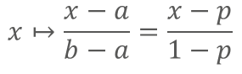
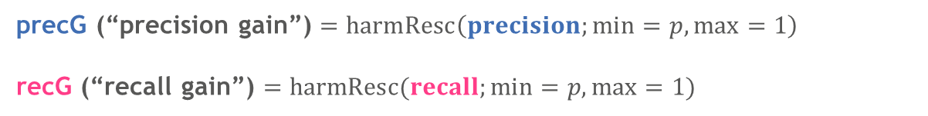
We can “fix” the PR curve by a smart choice of new coordinates (I/II)
Procedure: rescaling between p and 1
Linear rescaling:
$$x↦\frac{x−a}{b−a}=\frac{x−p}{1−p}$$
Apparently doesn’t work well…
“Harmonic” rescaling
$$x↦\frac{1/x−1/a}{1/b−1/a}=\frac{1/x−1/p}{1−1/p}=:harmResc(x;min=p, max=1)$$
Works!
precG (“precision gain”) $=harmResc\left(precision;min=p, max=1\right)$
recG (“recall gain”) $=harmResc(recall;min=p, max=1)$

Slide 27
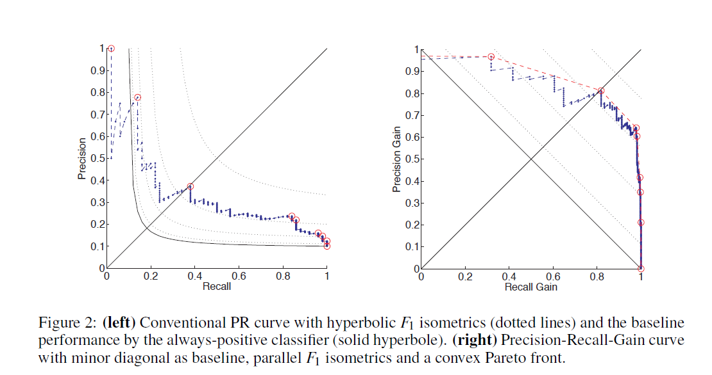
PR curve in “gain” coordinates is reminiscent of ROC curve
Always positive classifier

Slide 28
In these new coordinates, we regain several of the familiar ROC properties – but in PR space!
ROC curve
PR curve
PR-Gain curve
Interpretable area under the curve (AUC ROC)
No interpretation for the area (but some people still use it…)
Area is interpretable – related to the expected F1 score
Balance-invariance
The whole curve shifts when class balance shifts
Less susceptibility to imbalance than base PR
Universal baseline
No universal baseline – only baseline is the class imbalance ratio
Universal baseline – all classifiers with same F1 as always positive end in y=-x
Linearity & the convex hull
(convexity)
Not linear – convex hull has no meaning
Linearity & the convex hull
(convexity)

Slide 29
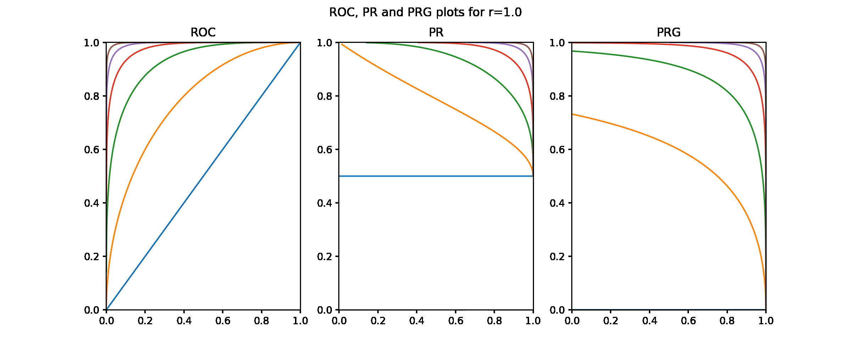
Comparison of how the curves change under imbalance shifts
TPR
Precision
PrecG
FPR
Recall
RecG

Slide 30
Conclusions and takeaways
The ROC curve has a set of useful properties (interpretable area, convexity, universal baseline) that the PR curve does not
ROC is also invariant to class imbalance – PR is not, and that is a good thing, because we need to understand the effect of imbalance
Under a suitable change of coordinates, the PR curve acquires the same properties as the ROC curve, while still being useful for analysis of imbalanced datasets
In particular, maximizing the area under it still makes sense; taking the convex hull also works

Slide 31
References
On the Precision-Recall-Gain curve, as well as on the nice properties of the ROC curve
P. Flach, M. Kull, Precision-Recall-Gain Curves: PR Analysis Done Right (NIPS 2015) https://research-information.bris.ac.uk/files/72164009/5867_precision_recall_gain_curves_pr_analysis_done_right.pdf
https://github.com/meeliskull/prg - repository to use the PRG curve
https://github.com/meeliskull/prg/blob/master/jupyter_notebook/python_prg.ipynb - Jupyter notebook example of usage
On linearity and the convex hull:
M.J.J. Scott et al, Realisable Classifiers: Improving Operating Performance on Variable Cost Problems (1998) http://www.bmva.org/bmvc/1998/pdf/p082.pdf

Slide 32
Thank you!

